Slide 1

Celebrate Antigua & Barbuda
39th Anniversary of Independence

Slide 2
7:00 P.M.
Co-Hosts Ms. Erene Anthony & Ms. Devolyn Carter
Welcome
MC Mr. Svens Telemaque
PRAYER Ms. Veron Henry

Slide 3
7:00 P.M.
Canada National Anthem:
O Canada! Our home and native land!
True patriot love in all of us command.
Car ton bras sait porter l’épée,
Il sait porter la croix!
Ton histoire est une épopée
Des plus brillants exploits.
God keep our land glorious and free!
O Canada, we stand on guard for thee.
O Canada, we stand on guard for thee.

Slide 4
7:00 P.M.
Antigua & Barbuda National Anthem:
Fair Antigua and Barbuda
We thy sons and daughters stand,
Strong and firm in peace or danger
To safe guard our native land.
We commit ourselves to building
A true nation brave and free.
Ever striving ever seeking
Dwell in love and unity.
https://youtu.be/LUUYFbhydwE

Slide 5
7:00 P.M.
Prime Minister’s Message
Hon Gaston Browne

Slide 6

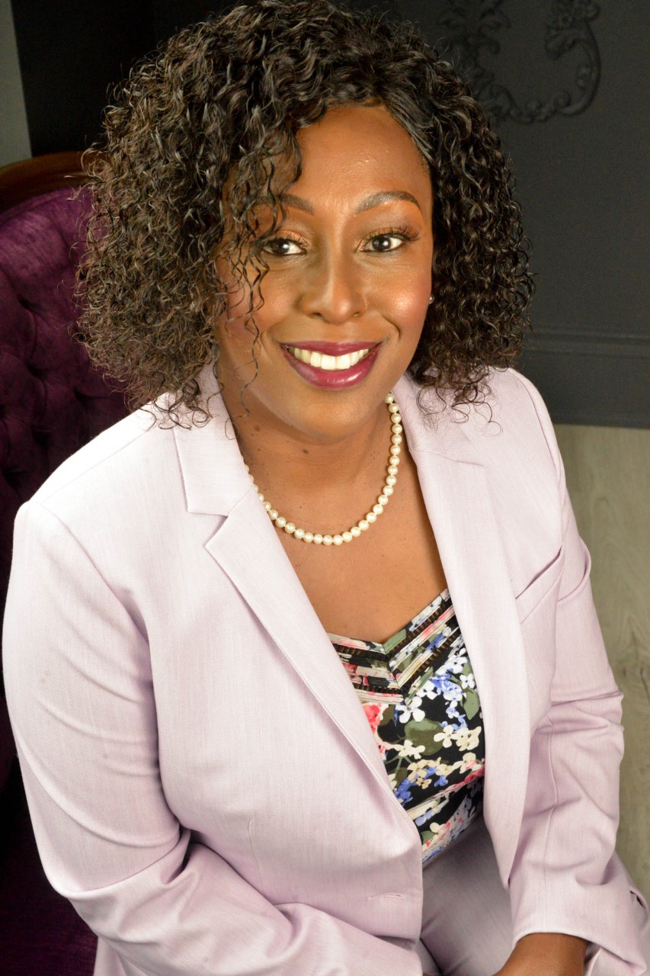
7:00 P.M.
Consul- General’s Message
Ms. Ann Marie Layne

Slide 7
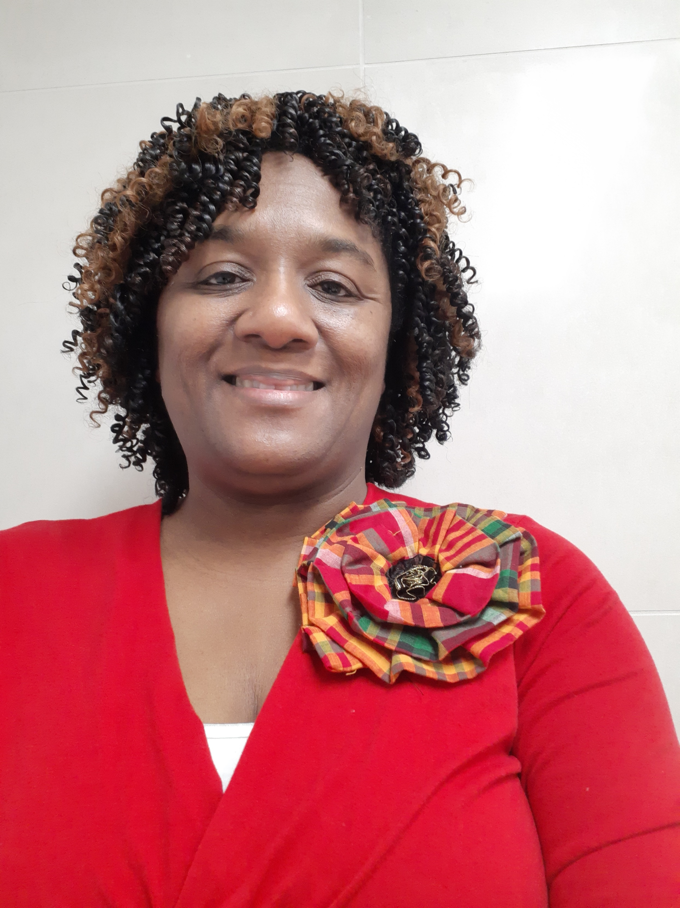
7:00 P.M.
President’s Message
Mrs. Juleen Barrington
Read by VP Cicely Jarvis

Slide 8
7:00 P.M.
Antigua The Beautiful Trumpeter- Erickson Skerritt
Independence Tribute King Obstinate 1981
https://youtu.be/qO0aHemnTGA

Slide 9
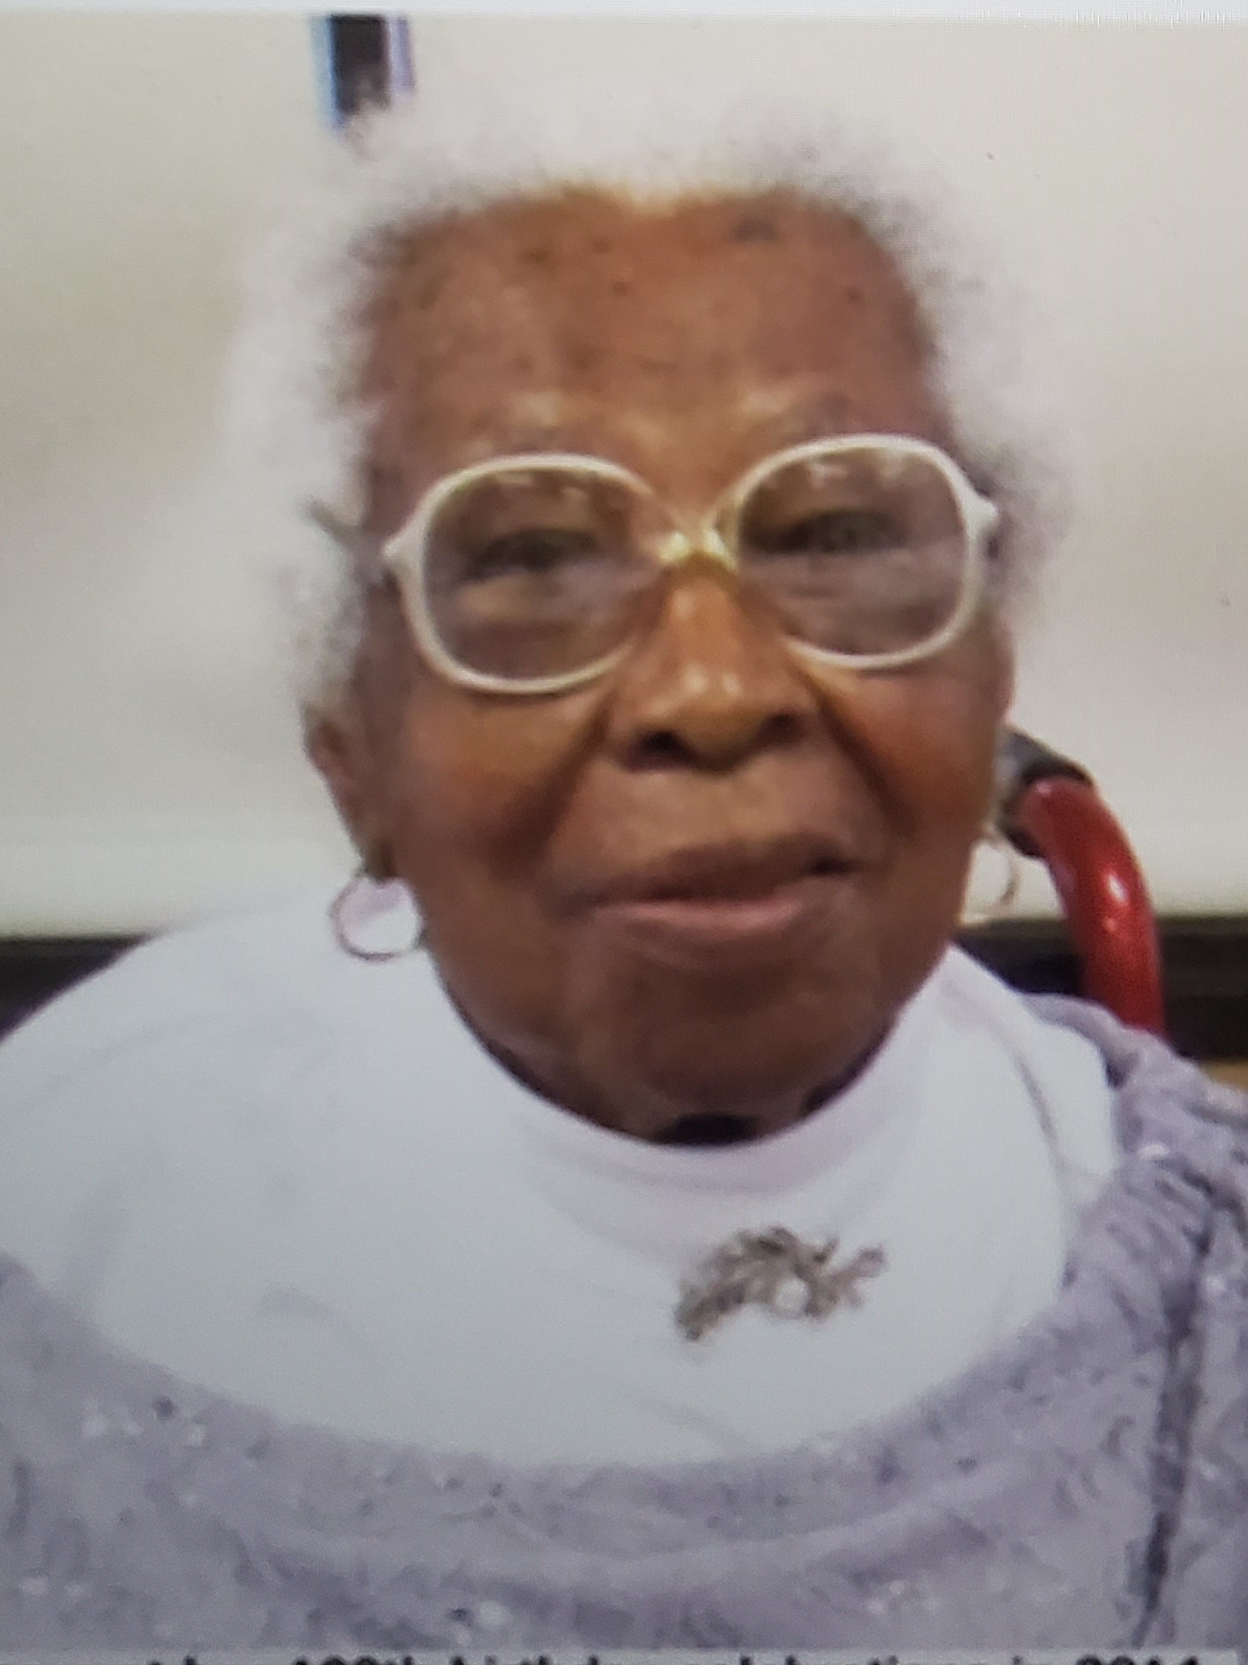
7:00 P.M.
What a Milestone!
106 yrs
Memoriam Mrs. Hilda Drucilla Spencer
Sunrise March 24,1914
Sunset June 20, 2020

Slide 10
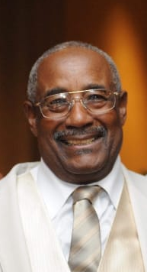
7:00 P.M.
Memoriam Mr. Winston Johnson
Sunrise May 13,1935
Sunset March 12, 2020

Slide 11
7:00 P.M.
Patrons
Athos Feron
Rideau Memorial Gardens

Slide 12
7:00 P.M.
Congratulatory Messages
  MP Anthony House Father
  MP Anju Dhillon
  MP Marc Miller
  Mayor Valerie Plante
  Mayor Benoit Dorais
  Depute Mayor Errol Johnson
  Councillor Marvin Rotrand
Toasts

Slide 13
7:00 P.M.
Entertainment
Our Pledge https://youtu.be/SS2BuWw5xMY
King Short Shirt Words by S. Humphreys
Piano Dr. George Roberts/ Tenor Mr. Arlen Seaton

Slide 14
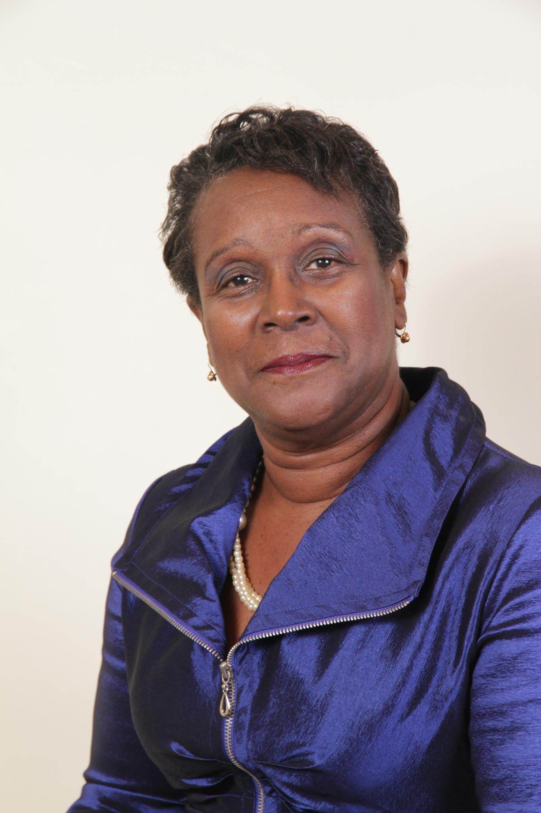
7:00 P.M.
GUEST SPEAKER:
  Mrs. Ketlyn Maitland Blades

Slide 15
7:00 P.M.
KETLYN MAITLAND-BLADES immigrated to Canada as a child.
Is a bilingual, dynamic, well-respected professional in the banking and financial industry, specializing in Securities Vault-Safecustody Operations.
Elected Vice President of the Securities Clearing Committee representing the six (6) Canadian chartered banks.
Is a Commissioner of Oaths for Quebec and exterior.
Recipient, Gold Award of Excellence for Decathletes, from the former Prime Minister of Canada, the late Honorable Pierre Elliot Trudeau.
Recipient of the Stephen Aismocoupoulos Award for citizenship.
March 5th, 2016 Recipient, Certificate of Achievement from the Liberal Riding Member of Parliament, House of Commons, Ottawa Canada..
March 2016 woman of distinction award “homage aux femmes” for decades of volunteer community involvement.
February 2017 black history month laureate.
June 17th, 2017 Canadian International Black Women to Watch Award (CIBW).
January 21st 2018 Recipient, Public Service Medal & Award from the Federal Liberal MP Alexandra Mendes.
Ladies & Gentlemen, The President of the Dominica Island Cultural Association of Montreal…

Slide 16
7:00 P.M.
PRESENTATIONS:
  *Highlights --Personalities of Antiguan Descent

Slide 17
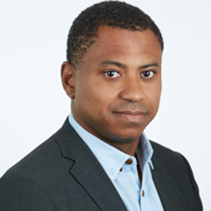
7:00 P.M.
PRESENTATIONS:
  Mr. Colin Hill
  Chairman, CEO and Co-Founder of Big Data

Slide 18
7:00 P.M.
Colin Hill is a leading voice in healthcare technology and precision medicine and brings impressive leadership experience in commercializing machine learning technologies in the biopharmaceutical and managed care industries. He co-founded GNS Healthcare, a leading AI-driven precision medicine company, in 2000 and has since served as Chairman & CEO. In 2020 the company launched the in silico patient, a highly accurate computer model of disease.
Colin sits on board of Biotelemetry Inc. (NASDAQ: BEAT), the leading mobile health information company, and PPD Inc. (NASDAQ: PPD), a leading global contract research organization. He is also a founding board member of TMed (Transforming Medicine: The Elizabeth Kauffman Institute), a non-profit foundation (501c3) dedicated to the advancement of personalized medicine. In 2016, he was appointed by Massachusetts Governor Charlie Baker to the Massachusetts Digital Health Council.
Colin was a founding member of the Board of Directors of AesRx, a biopharmaceutical company dedicated to the development of new treatments for sickle cell disease (acquired by Baxter in 2014). He was the founding chairman of O’Reilly Media’s Strata Rx in 2012, the first healthcare big data conference in the industry. In 2004, Colin was named to MIT Technology Review’s TR100 list of the top 100 innovators in the world under the age of 35.
He is a frequent speaker at national and international scientific and industry conferences and has appeared in numerous publications and television programs, including The Wall Street Journal, CNBC Morning Call & SquawkBox, Nature, Boston Globe, Politico, Forbes, Wired, and The Economist.
He graduated from Virginia Tech with a degree in physics and earned Master’s degrees in physics from both McGill University and Cornell University.

Slide 19
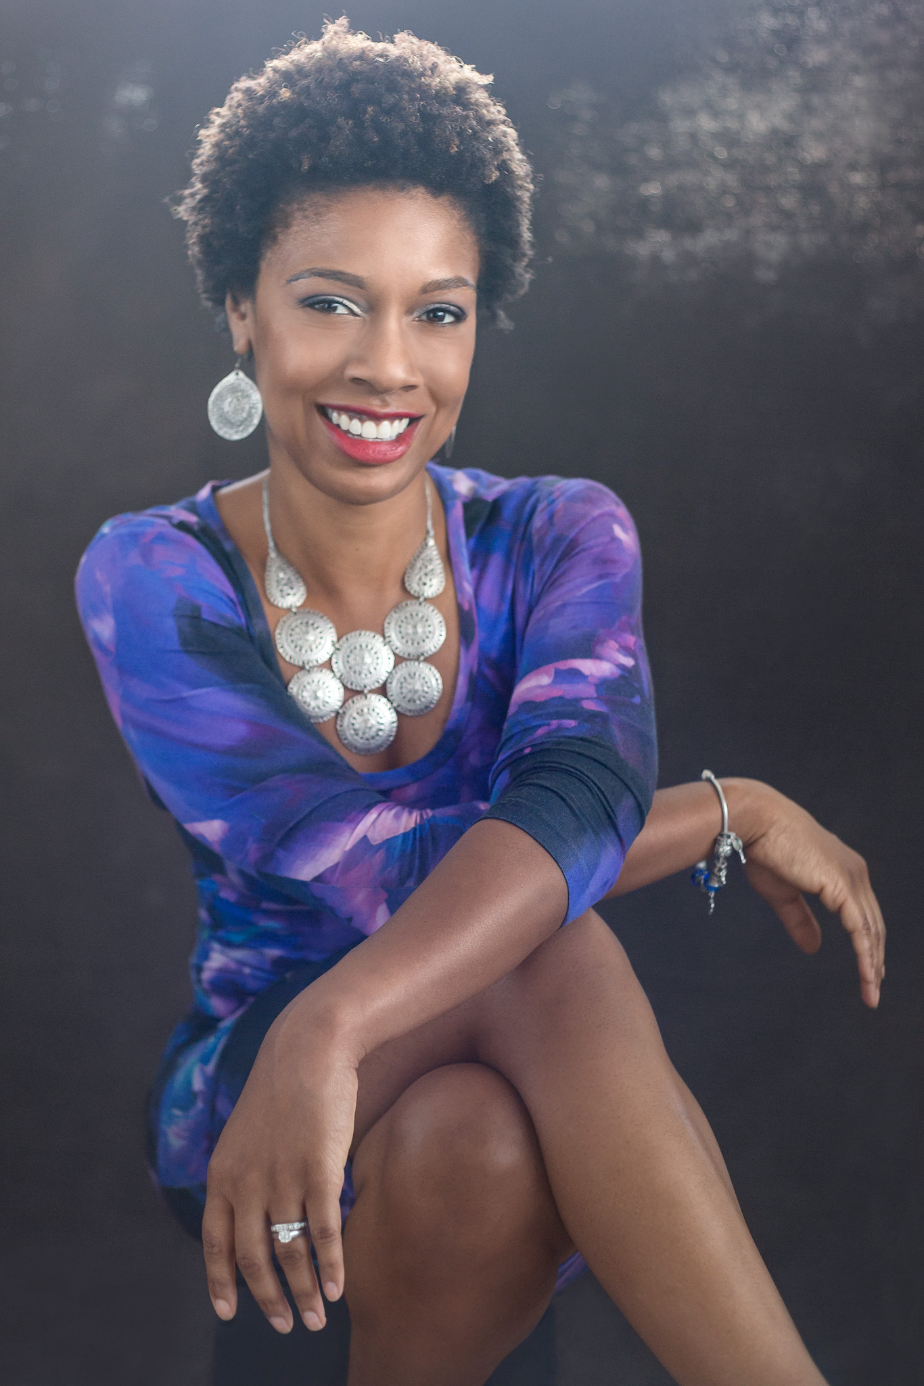
7:00 P.M.
PRESENTATIONS:
  Ms. Chantal Carter
  Founder of Love and Nudes

Slide 20
7:00 P.M.
Chantal Carter is an entrepreneur who has worked in the fashion industry for over 20 years as a
Stylist, Image Consultant and Style Director of Style Magazine.
She appreciates creating high-end simplicity in fashion and food. She displayed this talent as a
contestant in the first episode of Four Weddings Canada, winning 1st place for her wedding.
Chantal’s passion to uplift women of colour through fashion caused her to develop a diverse
skin tone lingerie line called Love & Nudes. This brand is more than just fashion, it’s also a
social movement connecting women and celebrating the beauty of difference through social
media and events.
She believes apparel and cosmetics should be accessible to all in a manner which allows them
to showcase their unique style and skin comfortably. Love & Nudes has been featured in media outlets such as CBC, City Line Ebony Magazine, Elle, Chatelaine, Flare, Toronto Star and more.

Slide 21
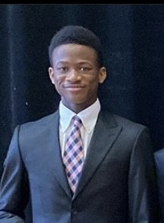
7:00 P.M.
PRESENTATIONS:
  *Ada Moore Bursary. - Mr. Israel Dial
  *Sickle Cell Association of Canada

Slide 22
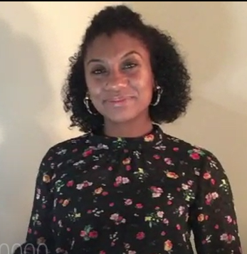
7:00 P.M.
ENTERTAINMENT
  STEELPAN: Ms. Fatima Wilson
  SOLO: Ms. Mahalia James
  DANCE https://youtu.be/F45pPipm4uk
  Antigua Independence Folk & Heritage 2013

Slide 23
7:00 P.M.
MISSION STATEMENT:
  *Executive and Social Committee
  *Photo Slide of past events
  * Digital Booklet

Slide 24

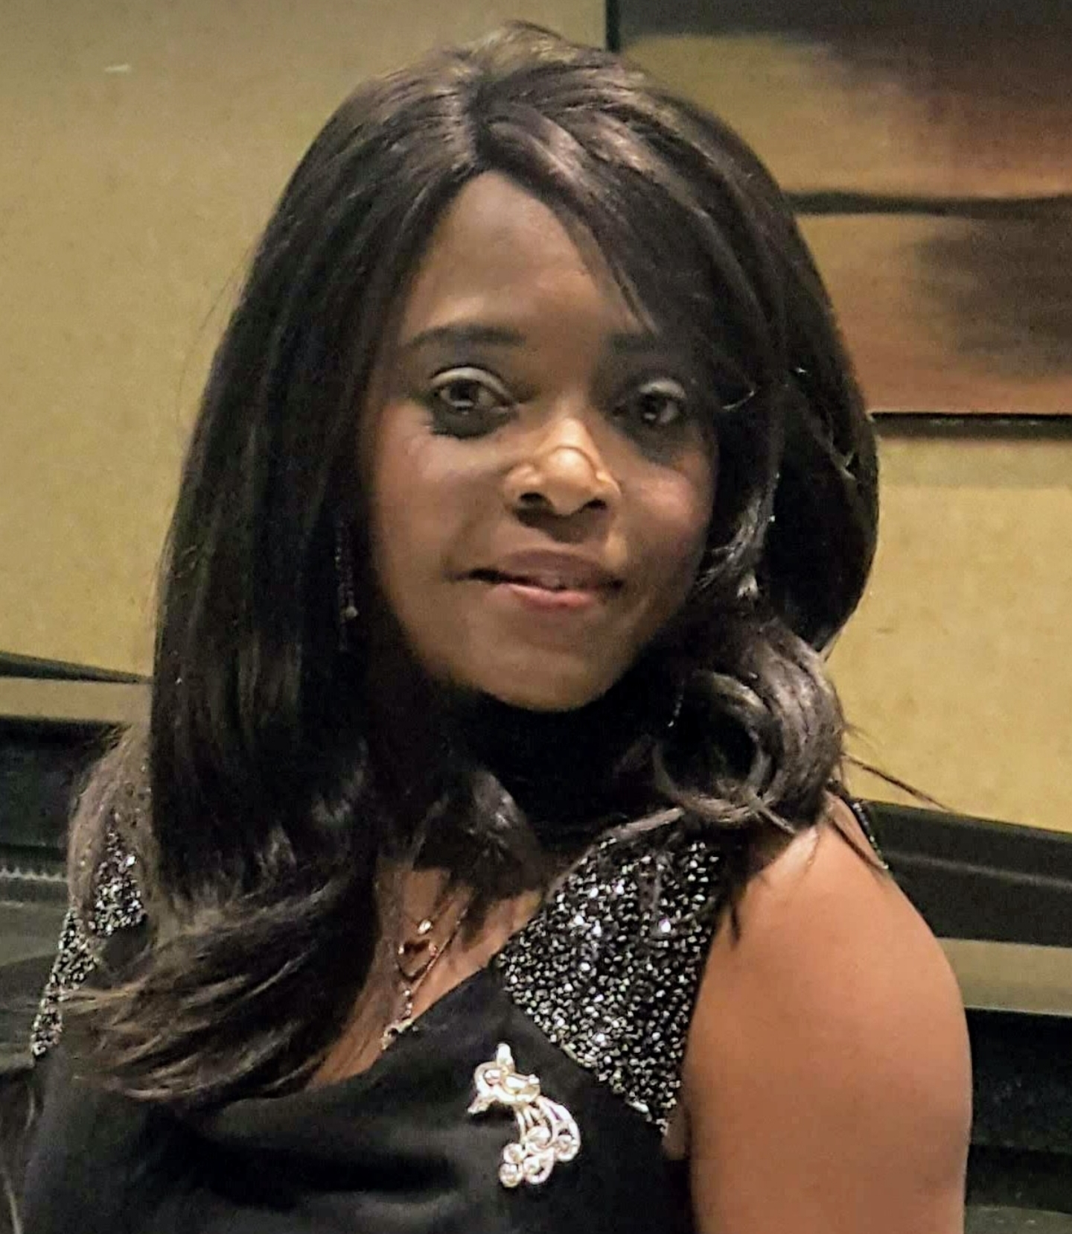
Mahalia James Marzucco

Slide 25
  DANCE https://youtu.be/F45pPipm4uk
  Antigua Independence Folk & Heritage 2013

Slide 26
Mahalia James Marzucco was born and raised in St. Vincent and the Grenadines, to proud
Parents Arthur Butler and Beryl James. She is the sixth of 10 siblings.
Mahalia migrated to Montreal Canada in December 1998. And is a devoted wife, mother and
Proud grandparent of Six beautiful grandchildren.
In 2000, she joined the Montreal West Church of God of Prophecy where she now serves as a
Praise and Worship Leader, Children’s Church Teacher and Director of the Women’s and Outreach Ministry Department. And wants to pursue her goal as a writer.

Slide 27


Slide 28
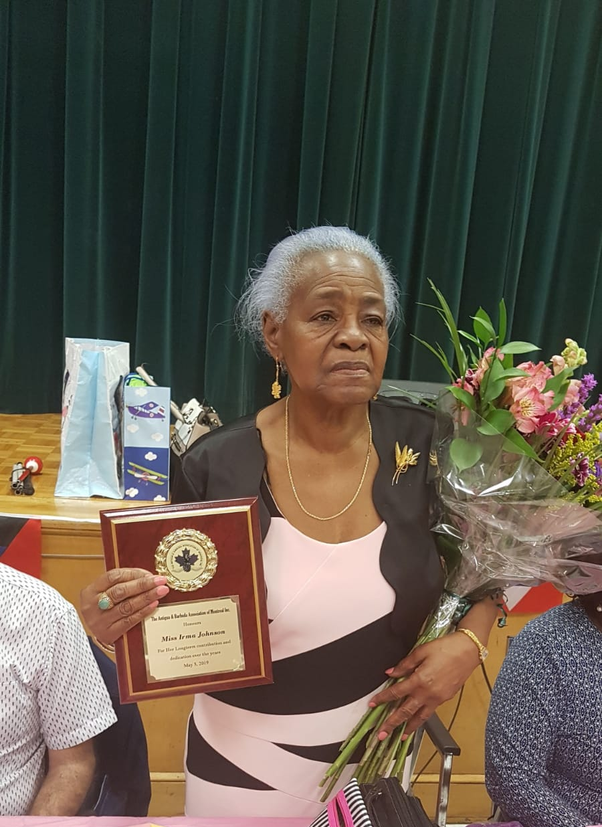
Ms. Irma Johnson
2019 Mother’s Day Honouree

Slide 29
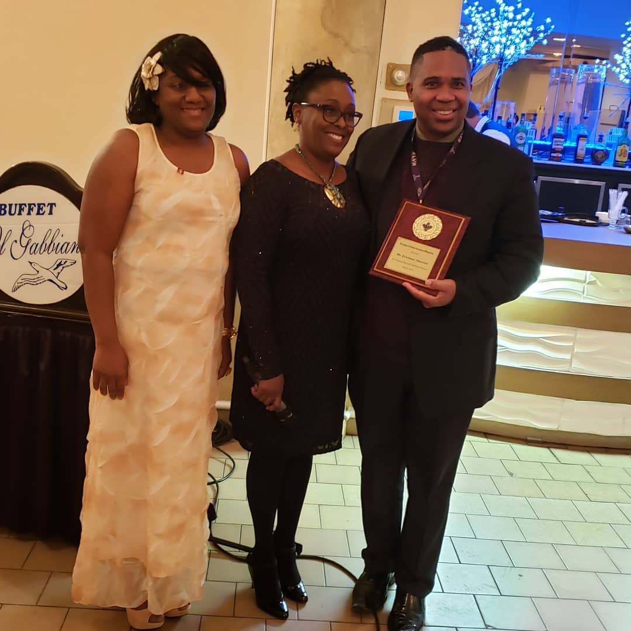
President, Juleen Barrington, Consul General- Ann Marie Layne and 2019 Special Presentation to Erickson Skerritt

Slide 30
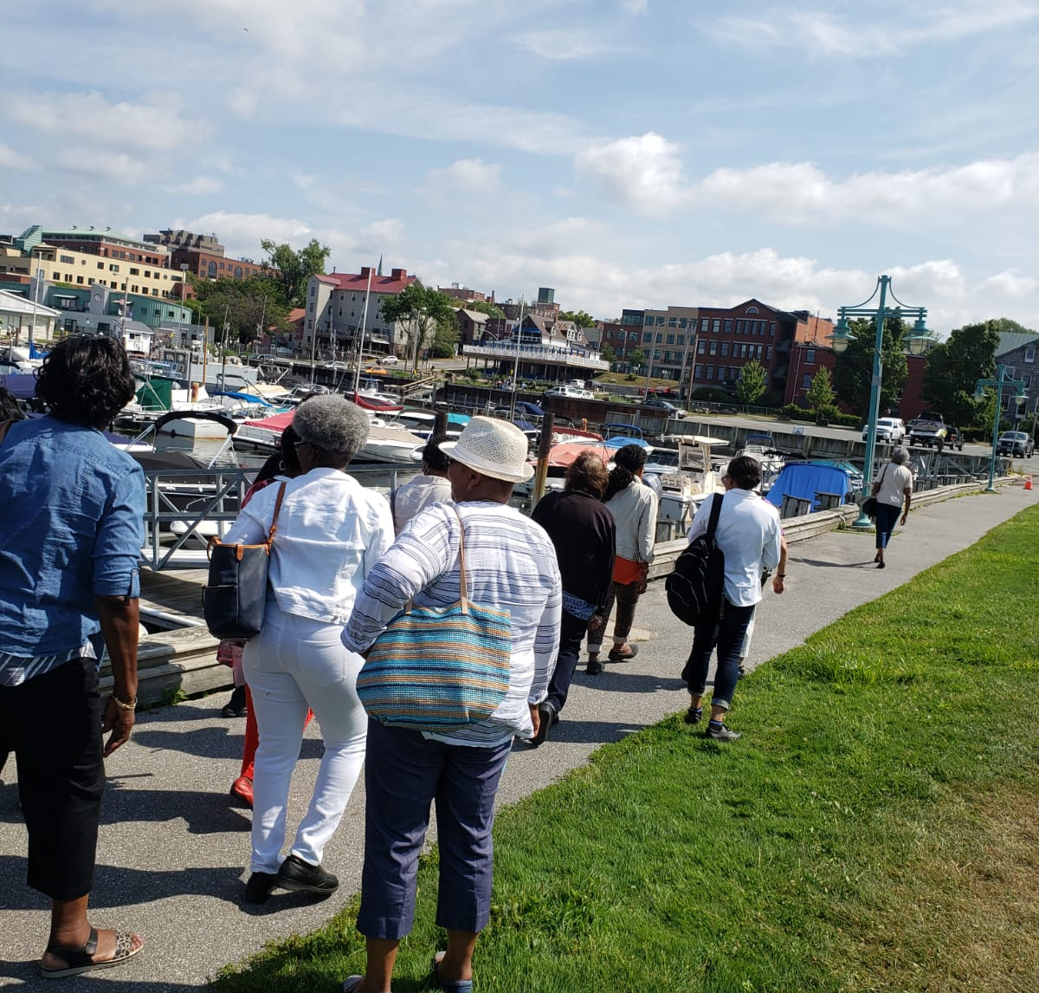
Vermont Summer Trip

Slide 31
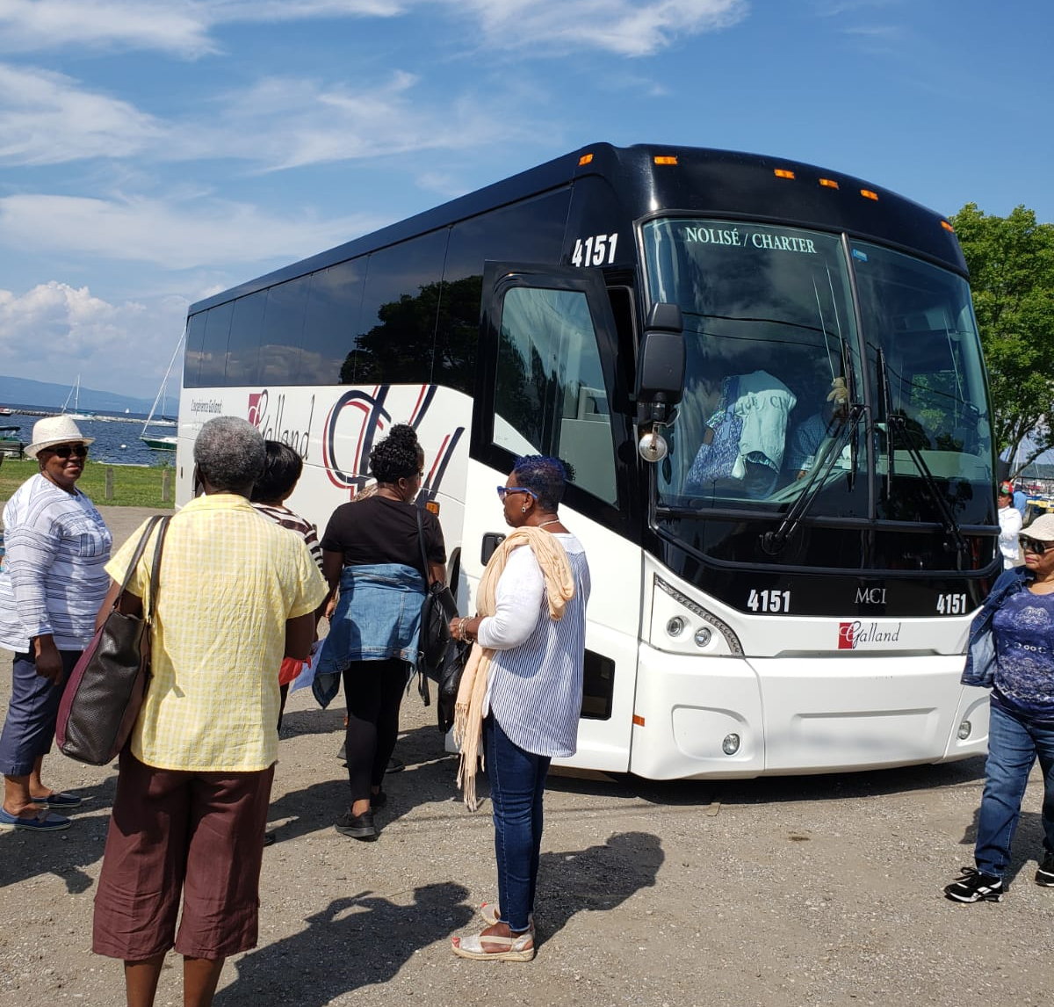
Enjoying the scenery of Vermont Harbour

Slide 32
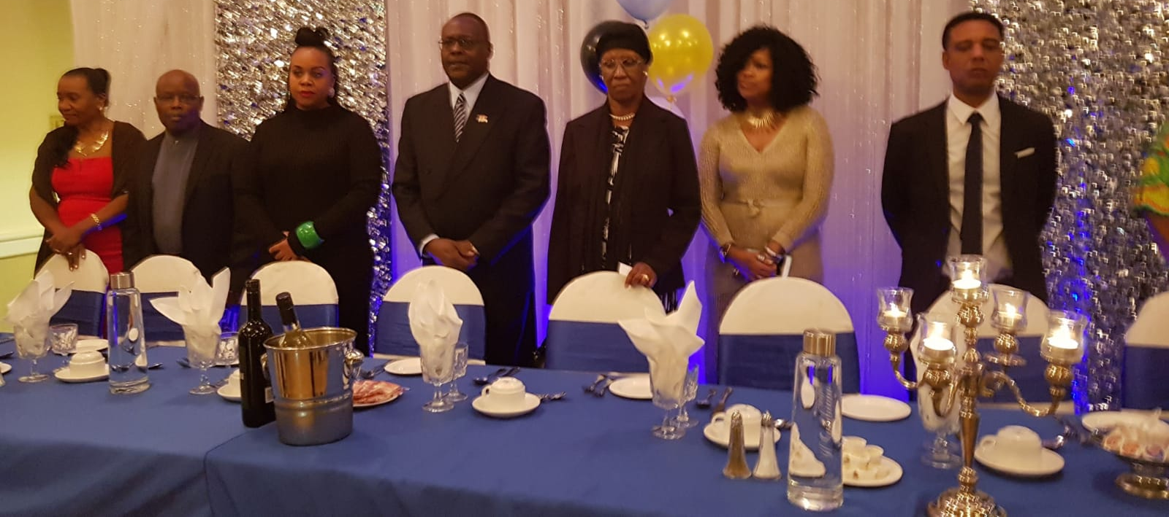
2018 Right Mr. Glenn Gomes- Honouree

Slide 33
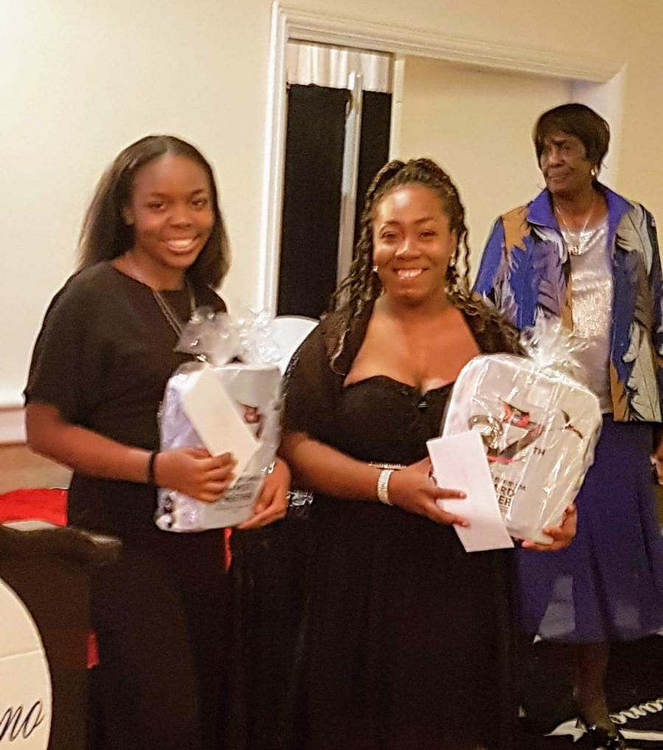
Ada Moore
Bursary Recipients

Slide 34
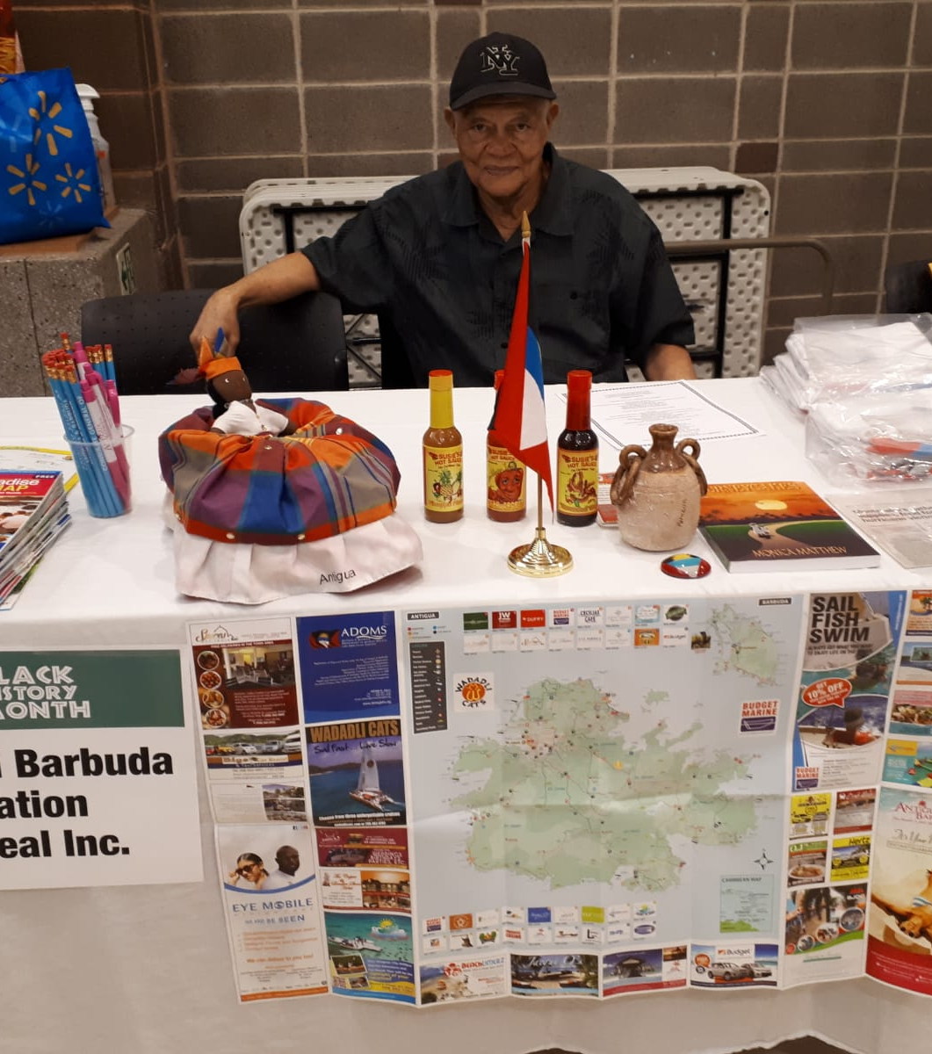
Black History Month Display at St Mary’s Hospital

Slide 35
7:00 P.M.
Congratulations& Best Wishes

Slide 36
7:00 P.M.
PATRONS:
  *Ads
THANK YOU:
LET THE DANCE BEGIN!

